Slide 1
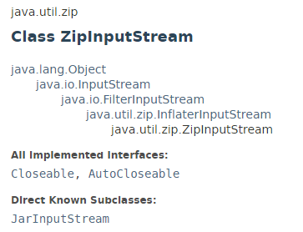
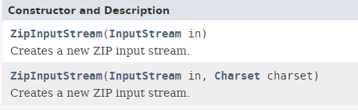
ZipInputStream
Java comes with “java.util.zip” library to perform the unzip operation.
Read ZIP file with “ZipInputStream”
Get the files to “ZipEntry” and output it to “FileOutputStream“

Slide 2
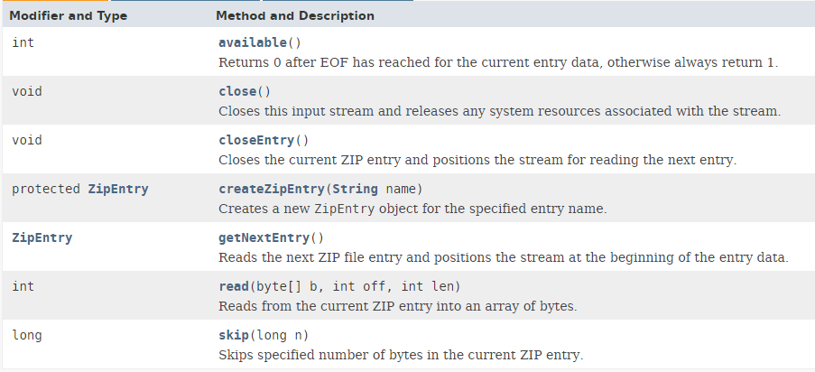
ZipInputStream

Slide 3
https://docs.oracle.com/javase/8/docs/api/index.html?java/util/zip/ZipInputStream.html

